Slide 1


National Association of Mathematicians, Inc.
2026 Faculty Conference on Research and Teaching Excellence (FCRTE)
April 10-11, 2026

Slide 2




Hosts and Sponsors

Slide 3
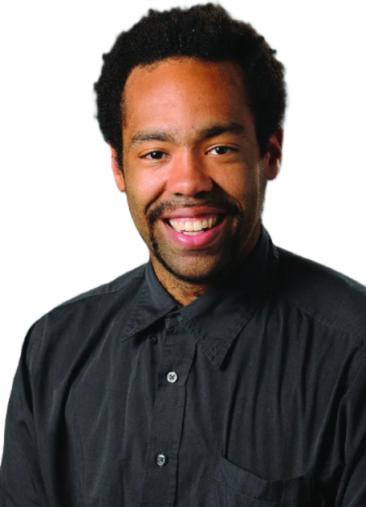
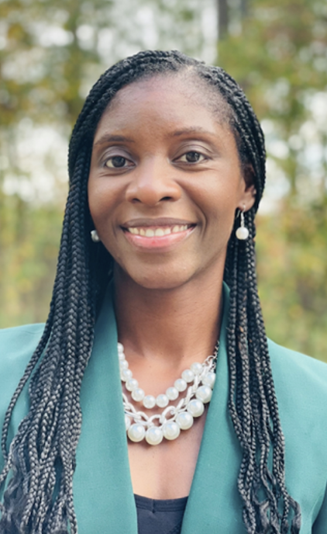
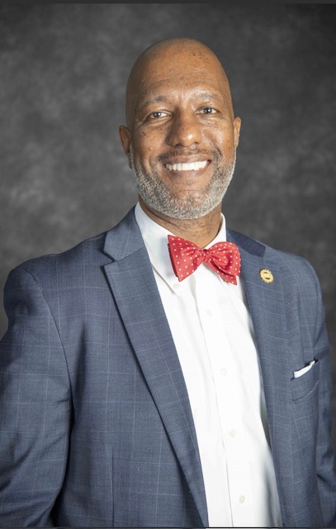
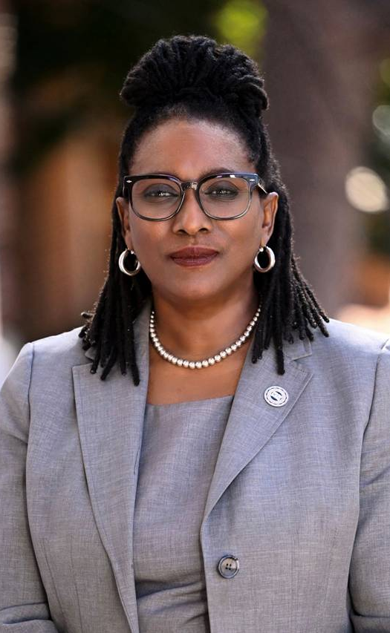
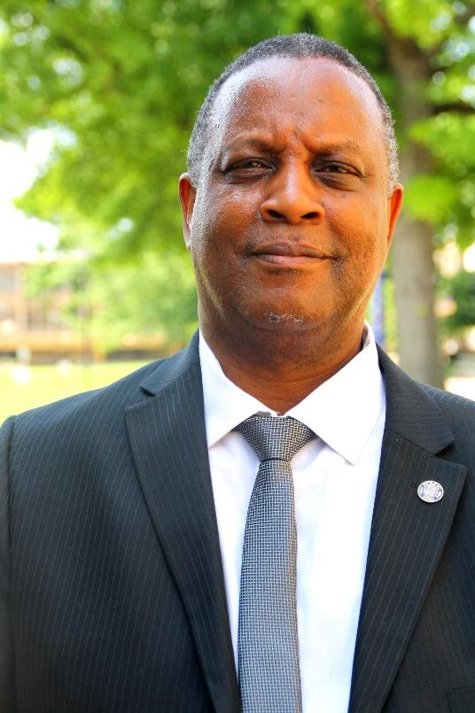
Welcome Remarks
Dr. Aris Winger, Executive Director of NAM, Inc. GGC
Dr. Lakeshia Legette Jones, Lead Local Organizer, CAU
Dr. Christopher K. Bass, Interim Dean of School of Arts and Sciences, CAU
Dr. Charlene D. Gilbert, Provost and Senior Vice President for Academic Affairs, CAU
Dr. Asamoah Nkwanta, President of NAM, Inc., MSU

Slide 4
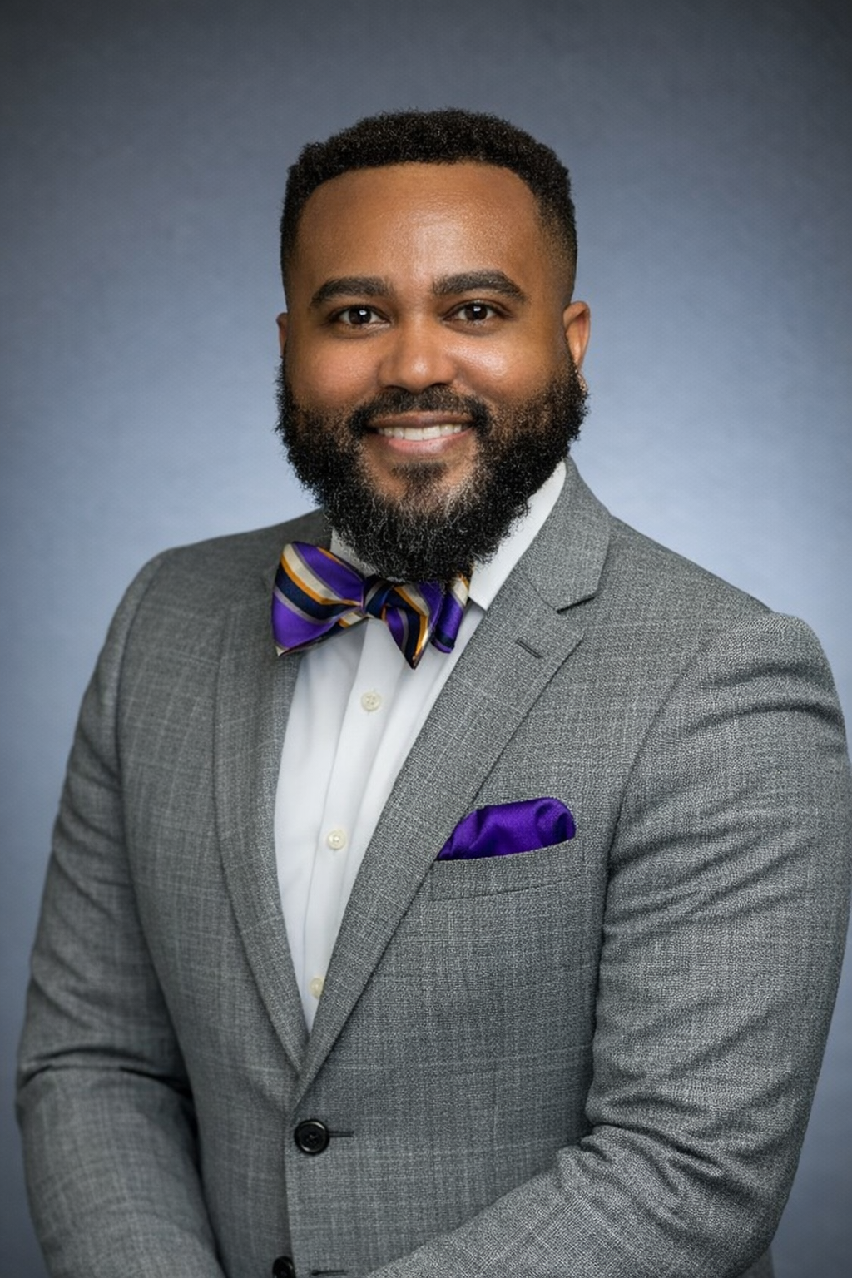
Friday, April 10, 2026 Schedule
2:30PM – 5:20PM Afternoon Session – Moderator: Dr. Maxine Harlemon, CAU
5:40PM – 6:40PM Albert Turner Bharucha-Reid Lecture: Dr. Samuel Ivy, PVAMU
Involutions, Root Systems, and Generalized Symmetric Spaces: From Structural Theory to Finite-Field Examples
6:40PM – 7:45PM NAM Recognition Banquet

Slide 5
Saturday, April 11, 2026 Schedule
8:00AM – 8:50AM Breakfast
9:00AM – 11:00AM Morning Session – Moderator: Dr. Phyllis Okwan, SUBR
11:15AM – 12:00PM Panel Discussion – Moderator: Dr. Aris Winger, GGC
Generative AI as a Learning Partner: Setting Boundaries and Expectations
Panelist: Dr. Noel Bourne (TSU), Dr. Rachel Vincent-Finley (SUBR), and Dr. Maxine Harlemon (CAU)
12:00PM – 1:00PM Lunch
1:00PM – 3:30PM Afternoon Session – Moderator: Dr. Alvina Atkinson, GGC
3:30PM – 3:45PM Closing Remarks

Slide 6
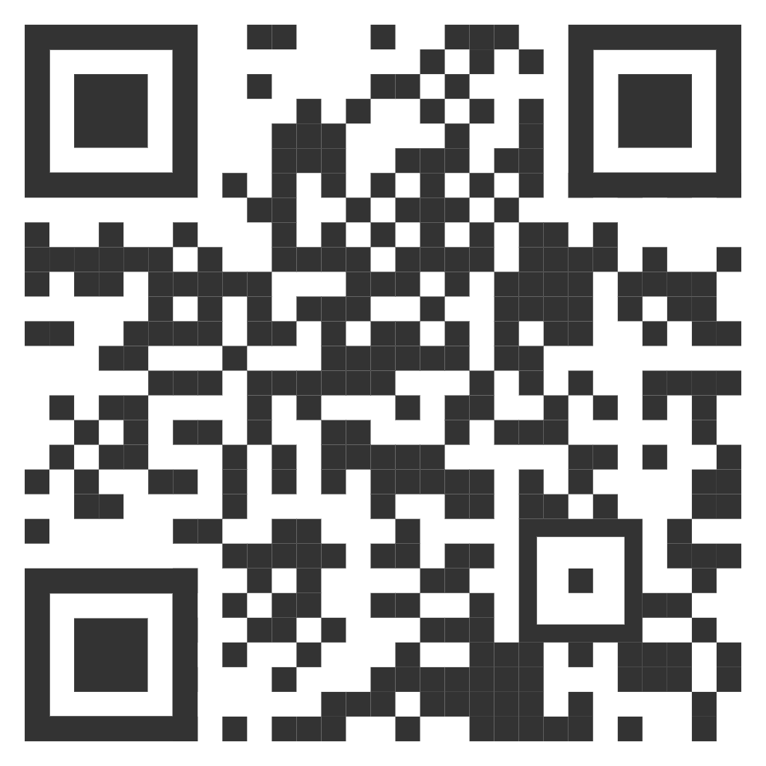
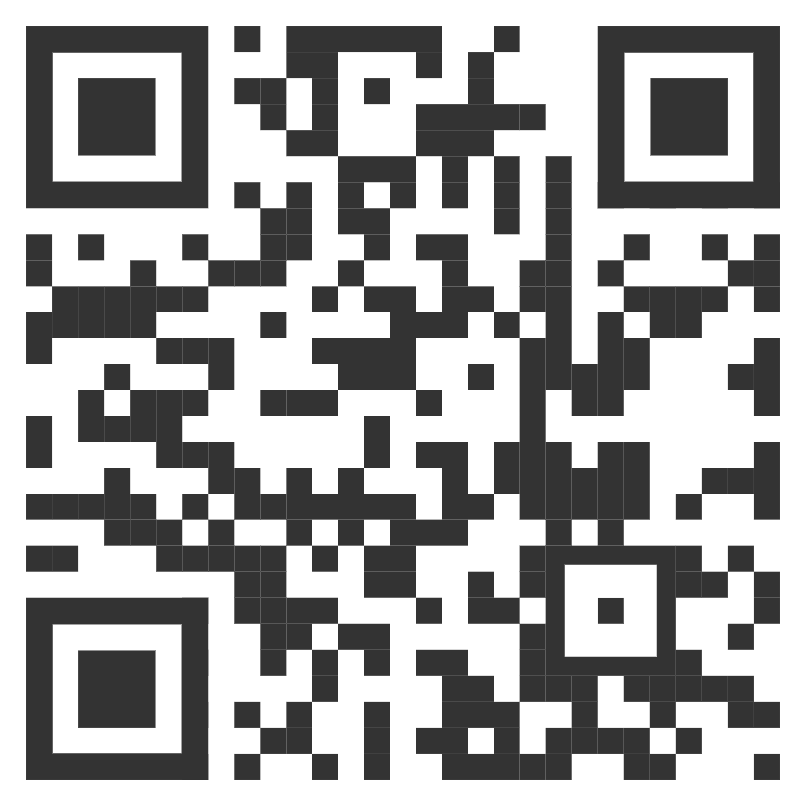
Program and Book of Abstracts
FCRTE Program
FCRTE Book of Abstracts

Slide 7
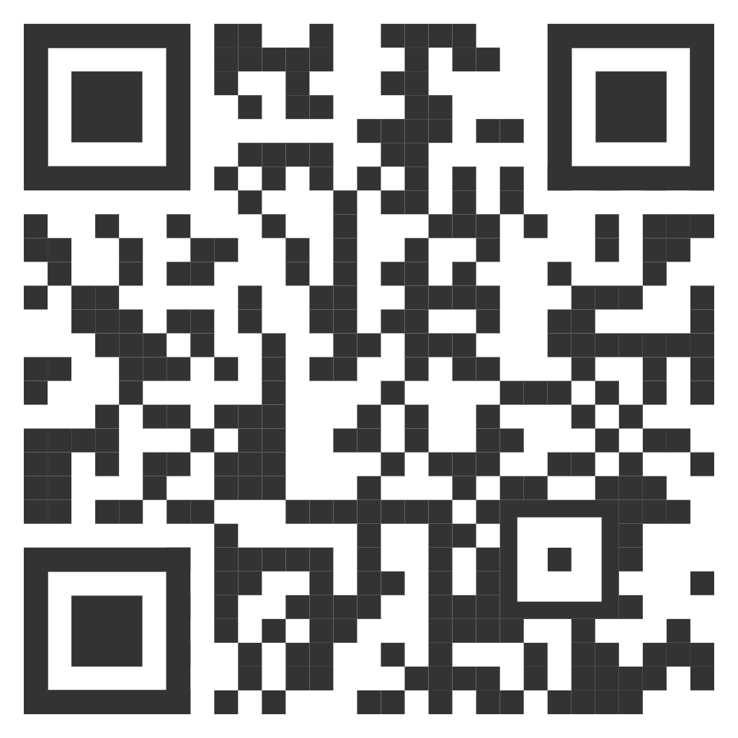
NAM, Inc. 2026 Giving Campaign
By supporting NAM, you sustain signature programming, strengthen our community, and advance a legacy of empowering mathematicians. Your investment directly impacts students, early-career scholars, and faculty by fostering opportunities for mentorship, collaboration, and scholarly growth.

Slide 8

SAVE THE DATE:
September 25 – 27, 2026
NAM Undergraduate MATHFest XXXVI
Hosted by Winston-Salem State University

